Slide 1


Session 10
Python Syntax - 1
FILEO OPERATIONS

Slide 2
Learning Outcomes
Reading Files
Writing files
Reading CSV files

Slide 3
1. Reading Files
There are no modules required as Python by default has the file input/output methods. when opening files we create an instance of the object as shown below
NOTE: we must always close the file when we open it
f = open('test. txt', mode = 'r')
print(f.name)
print(f.mode)
f.close()
test.txt
r
A file can be opened in multiple modes. read() and write() are most commonly used modes

Slide 4
There are 3 methods to read data from a file
read()
readline()
readlines()
The read() method reads the entire content of the file as a single string data
f = open('test. txt', 'r')
x = f.read()
print(x)
f.close()
1) This is a test file!!
2) This is the second line
3) This is the third line
4) This is the fourth line
5) This is the fifth line
6) This is the sixth line
7) This is the seventh line
8) This is the eight line
9) This is the ninth line
10) This is the tenth line

Slide 5
The readline() method reads a single line from the file at a time.
f = open('test. txt', 'r')
x = f.readline()
print(x)
f.close()
1) This is a test file!!
This means that we can put the readline function inside a for loop to read the entire file.
f = open('test.txt','r')
for i in range(0,10):
x = f.readline()
print(x)
f.close()

Slide 6
The readlines() method gives us a list with every element in the list as a line from the file.
f = open('test. txt', 'r')
x = f.readlines()
print(x)
f.close()
['1) This is a test file!!\n', '2) This is the second line\n', '3) This is the third line\n', '4) This is the fourth line\n', '5) This is the fifth line\n', '6) This is the sixth line\n', '7) This is the seventh line\n', '8) This is the eight line\n', '9) This is the ninth line\n', '10) This is the tenth line']
Notice the \n at the end of every item in the list.
when you press the enter key it always inputs a new line character at the end. Hope you remember the new line character from the star pattern problem in session 5 (loops)
This is the reason why we got that extra lines when using the readline() method.
The print function puts its \n and also the string itself has a \n which causes a double-enter key press. we can solve this issue by simply making the print statement not put \n automatically.

Slide 7
Guess the output of the below code
f = open('test. txt', 'r')
x = f.readlines()
print(x)
f.close()
seek()
tell()
with open('test.txt') as f:
print(f.tell())
print(f.read())
print(f.tell())
f.seek(0)
print(f.tell())

Slide 8
Output of the previous code
0
1) This is a test file!!
2) This is the second line
3) This is the third line
4) This is the fourth line
5) This is the fifth line
6) This is the sixth line
7) This is the seventh line
8) This is the eight line
9) This is the ninth line
10) This is the tenth line
273
0

Slide 9
Output of the previous code
0
1) This is a test file!!
2) This is the second line
3) This is the third line
4) This is the fourth line
5) This is the fifth line
6) This is the sixth line
7) This is the seventh line
8) This is the eight line
9) This is the ninth line
10) This is the tenth line
273
0

Slide 10
2. Writing files
To write to a file we must open the file in write mode. The file name provided will be created automatically. If we provide a file name that already exists then everything in the file will be deleted.
To edit a file we must use the append mode.
Lets we want to create a copy of the test.txt file
r = open('test. txt', mode = 'r')
w = open('test_copy.txt',mode = 'w')
x = r.read()
w.write(x)
r.close()
w.close()

Slide 11
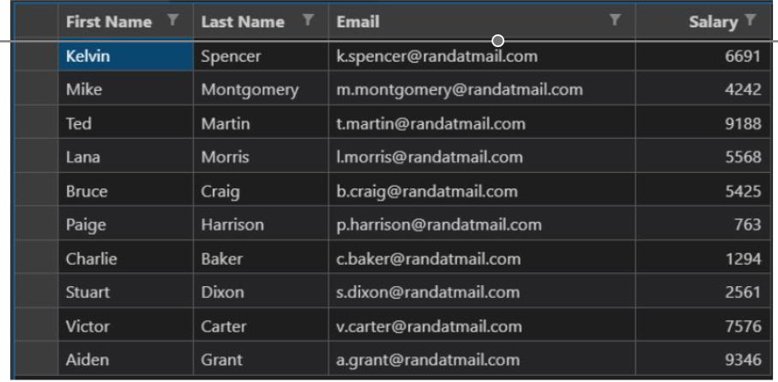
3. READING CSV FILE
CSV files are similar to Excel sheets which allows us to store data as rows and columns. As the name suggests (CVS - Comma Separated Values) are just simple text files with every column separated using commas and every row separated using new lines.

Slide 12
TASK1: calculate the sum of salaries of all employees in the below CSV file
We Can first read the content of the file using the open() method
f = open(‘data. csv’)
x = f.read()
print(x)
"First Name", "Last Name", "Email", "Salary"
"Kelvin", "Spencer", "k.spencer@randatmail.com", "6691"
"Mike", "Montgomery", "m.montgomery@randatmail.com", "4242"
"Ted", "Martin", "t.martin@randatmail.com", "9188"
"Lana", "Morris", "l.morris@randatmail.com","5568"
"Bruce", "Craig", "b.craig@randatmail.com", "5425"
"Paige", "Harrison", "p.harrison@randatmail.com", "763"
"Charlie", "Baker", "c.baker@randatmail.com", "1294"
"Stuart", "Dixon", "s.dixon@randatmail.com", "2561"
"Victor", "Carter", "v.carter@randatmail.com", "7576"
"Aiden", "Grant", "a.grant@randatmail.com", "9346"

Slide 13
f = open('data.csv')
# discarding the first line as it is the columns
x = f.readline()
y = f.readline()
print(y)
"Kelvin", "Spencer", "k.spencer@randatmail.com", "6691"
a = y.split(',')
print(a)
['"Kelvin"', '"Spencer"', '"k.spencer@randatmail.com"', '"6691"\n']
b =a[3]
print(b)
"6691"
c = b.strip('"\n')
print(c)
6691
d = int(c)
print(d)
6691

Slide 14
REVISION
Reading Files
Writing files
Reading CSV files
HOMEWORK
Write a program to read all the characters from the file(“data.txt”) and display in uppercase.
Write a program in Python to find the number of characters in the first line of a text file (“data.txt”) using readlines().
Write a program to read all the characters from the file(“data.txt”) and display in uppercase
Write a program to count the number of vowels in a file.
Write a program to write the following data in a file “data.txt”.
Write a program to read data from “data.txt” and write in another file “dest.txt”
Write a program to read all data from “data.txt” and write in another file “dest.txt” except the vowels.
Write a program to read data from the file “data.txt” and count the frequency of word input from the user.

Slide 15
HOMEWORK SOLUTION
#TASK 1 f = open("data.txt", 'r')
d = f.read( )
print(d.upper( ))
HOMEWORK SOLUTION
#TASK 2 f = open("data.txt", 'r')
d = f.readlines( )
print(len(d[0]))

Slide 16
THANK - YOU

